Slide 1
Self Organizing Maps – Kohonen Maps

Slide 2
Self Organizing Map (or Kohonen Map or SOM)
KSOM is a type of Artificial Neural Network which is also inspired by biological models of neural systems from the 1970s.
It follows an unsupervised learning approach and trained its network through a competitive learning algorithm.
SOM is used for clustering and mapping (or dimensionality reduction) techniques to map multidimensional data onto lower-dimensional which allows people to reduce complex problems for easy interpretation.
SOM has two layers, one is the Input layer and the other one is the Output layer.
A self-organizing map (SOM) is an unsupervised neural network that reduces the input dimensionality in order to represent its distribution as a map.
Therefore, SOM forms a map where similar samples are mapped closely together.

Slide 3
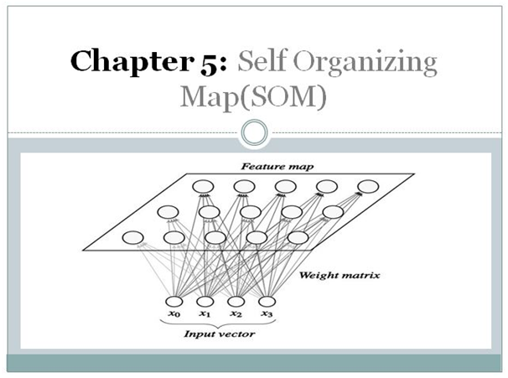
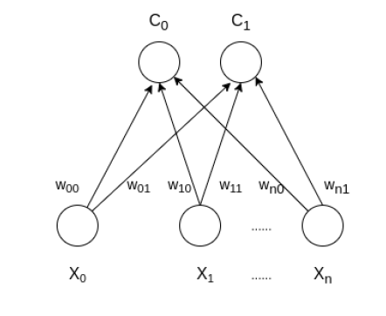
Self Organizing Map (or Kohonen Map or SOM)
The architecture of the Self Organizing Map with two or more clusters and n input features of any sample is given below:

Slide 4
How do SOM works?
Let’s say an input data of size (m, n) where m is the number of training examples and n is the number of features in each example.
First, it initializes the weights of size (n, C) where C is the number of clusters.
Then iterating over the input data, for each training example, it updates the winning vector (weight vector with the shortest distance (e.g Euclidean distance) from training example).
Weight updation rule is given by :
w_{ij} = w_{ij}(old) + alpha(t) * (x_{i}^{k} - w_{ij}(old))
where alpha is a learning rate at time t, j denotes the winning vector, i denotes the i^{th} feature of training example and k denotes the k^{th} training example from the input data.
After training the SOM network, trained weights are used for clustering new examples. A new example falls in the cluster of winning vectors.

Slide 5
How do SOM works?
SOMs iteratively run three stages until convergence:
Competition
Cooperation
Adaptation
In Competition stage, we go over all the input data points. Then, for each, we measure the distance between its vector and each neuron in the lattice.
After calculating the distances, it find the neuron closest to the input vector neuron. This stage is called competition because the neurons compete in similarity to our data point.
The cooperation phase begins after finding the winning neuron. In it, we find the winning neuron’s neighbors.
In adaptation phase neuron are updated

Slide 6
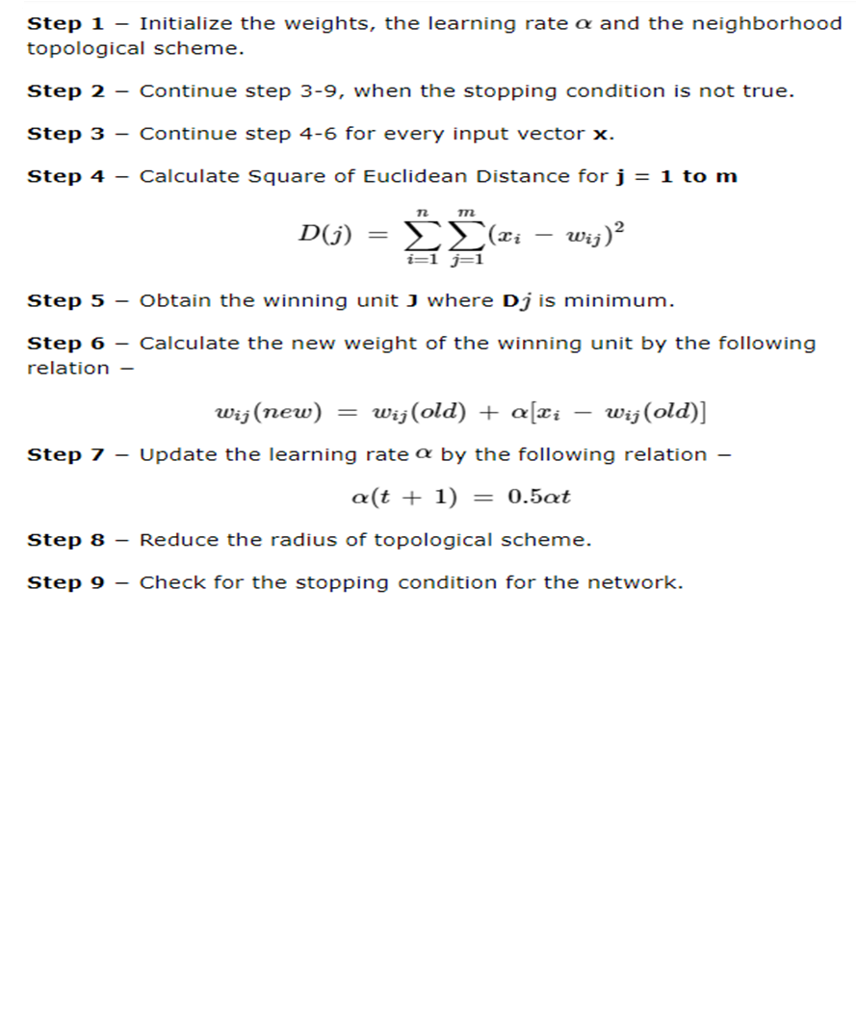
SOM Algorithm

Slide 7
Advantages of Kohonen Self-Organizing Maps (KSOM)
Nonlinear dimensionality reduction:
KSOMs can be used to represent high-dimensional data in a low-dimensional space, while preserving the topological relationships between the data points.
This can help to reveal underlying patterns and structure in the data, which may not be apparent in the high-dimensional space.
Unsupervised learning:
KSOMs are a type of unsupervised learning technique, which means that they do not require labeled data for training.
This makes them useful for tasks where labeled data is not available or is too expensive to obtain.
Clustering and visualization:
KSOMs can be used for clustering and visualization of complex data.
The resulting low-dimensional representation of the data can be used to identify clusters and patterns in the data, which can be useful for exploratory data analysis and data mining.
Robustness to noise:
KSOMs are relatively robust to noise and can still perform well even if the input data contains some level of noise or errors.
Easy interpretation:
The output of a KSOM can be easily visualized and interpreted, which can be useful for identifying trends and patterns in the data, and for communicating the results to others.
Flexibility:
KSOMs can be adapted to a wide range of data types, including continuous, discrete, and categorical data.

Slide 8
Disadvantages of Kohonen Self-Organizing Maps (KSOM)
Sensitivity to initial conditions:
The performance of a KSOM can be sensitive to the initial conditions of the network, such as the initial weights of the neurons in the grid.
This means that different initializations can result in different final solutions, and it may be necessary to run the algorithm multiple times to obtain a stable solution.
Computational complexity: T
he computational complexity of KSOMs can be high, particularly for large datasets and complex network architectures.
This can make training and testing the network time-consuming and computationally expensive.
Difficulty in determining the optimal network size:
Choosing the optimal network size, or the number of neurons in the grid, can be difficult and is often a trial-and-error process.
Using too few neurons can result in poor representation of the input data, while using too many neurons can lead to overfitting.
Limited to low-dimensional data:
KSOMs are typically used for dimensionality reduction of high-dimensional data. However, the performance of KSOMs may degrade as the dimensionality of the input data increases, making them less effective for very high-dimensional datasets.
Limited interpretability:
While the output of a KSOM can be easily visualized, interpreting the resulting clusters or patterns in the data can be difficult.
The meaning of the clusters or patterns may be unclear, and it may be necessary to combine KSOMs with other techniques to gain a deeper understanding of the data.

Slide 9
Summary of Kohonen Self-Organizing Maps (KSOM)
To summarize, Kohonen SOMs can be used for image and signal processing, text and data mining, and bioinformatics.
They have also been used to analyze gene expression data, identify patterns in social network data, and classify images based on visual features.

Slide 10
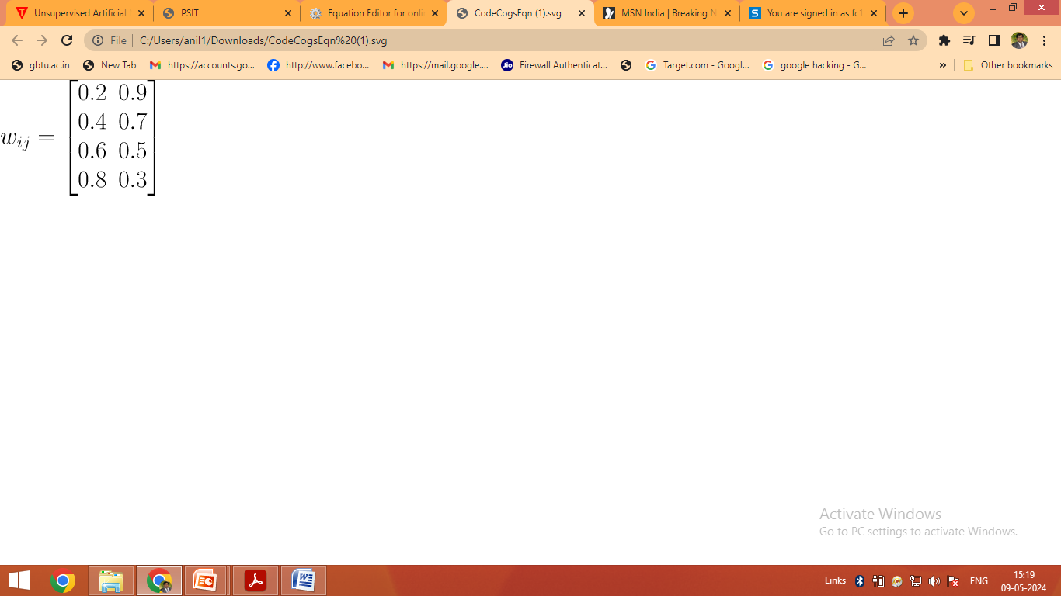
Solved Numericals (KSOM)
Construct KSOM to cluster for following data vectors:
X1=[0 0 1 1], X2=[1 0 0 0], X3=[0 1 1 0], X4=[0 0 0 1]
Number of clusters=2 and Initial learning rate α=0.5
Solution:
Number of initial vectors n=4 (i=1 to 4)
Number of clusters m =2(j=1 to 2)
x1
w11
w12
C1
x2
w21
Initial weight
w22
w31
x3
w32
C2
w41
w42
x4

Slide 11
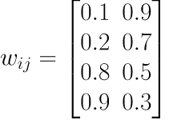
old
For input vector x1=[0 0 1 1] calculate the distance
D(1)= (0 - 0.2)^2 + (0 - 0.4)^2 + (1 - 0.6)^2 + (1 - 0.8)^2
D(1)=0.4
D(2)= (0 - 0.9)^2 + (0 - 0.7)^2 + (1 - 0.5)^2 + (1 - 0.3)^2
D(2)=2.04
Here D1<D2 cluster 1 is wining therefore update weight of wining cluster 1
w11= 0.2 +0.5*(0 - 0.2)=0.1
w21= 0.4 +0.5*(0 - 0.4)=0.2 thus updated
w31= 0.8 +0.5*(1 - 0.6)=0.8
w41= 0.9 +0.5*(1 - 0.8)=0.9

Slide 12
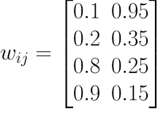
old
For input vector x2=[1 0 0 0]
D(1)= (1 - 0.1)^2 + (0 - 0.2)^2 + (0 - 0.8)^2 + (0 - 0.9)^2
D(1)=2.3
D(2)= (1 - 0.9)^2 + (0 - 0.7)^2 + (0 - 0.5)^2 + (0 - 0.3)^2
D(2)=0.84
Here D2<D1 cluster 2 is wining therefore update weight of wining cluster 2
w11= 0.9 +0.5*(1 - 0.9)=0.95
w21= 0.7 +0.5*(1 - 0.7)=0.35 thus updated
w31= 0.5 +0.5*(0 - 0.5)=0.25
w41= 0.3 +0.5*(0 - 0.3)=0.15

Slide 13
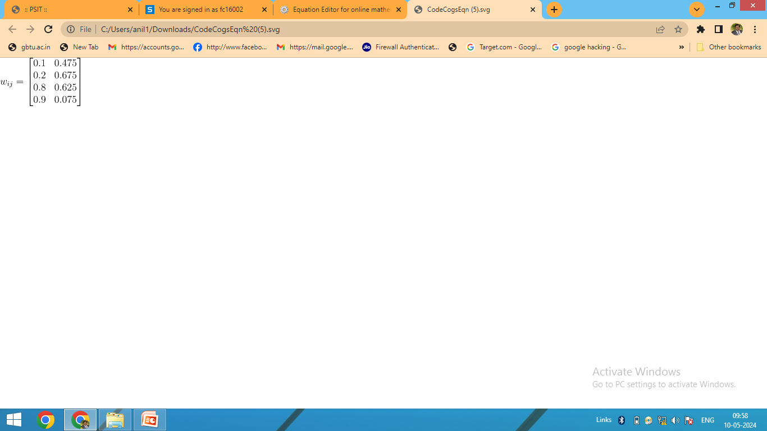
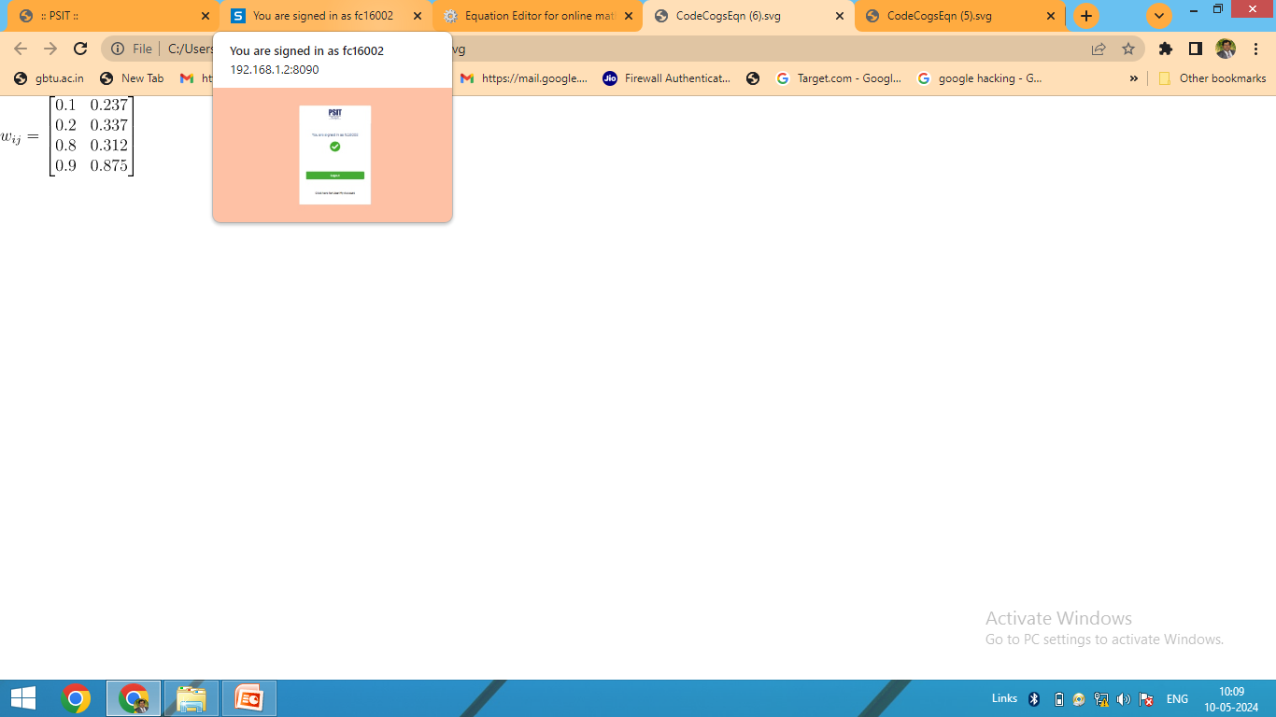
old
For input vector x4=[0 0 0 1]
D(1)= (0 - 0.1)^2 + (0 - 0.2)^2 + (0 - 0.8)^2 + (1 - 0.9)^2
D(1)=0.645
D(2)= (0 - 0.475)^2 + (0 - 0.675)^2+ (0 - 0.625)^2 + (1- 0.75)^2
D(2)=1.13
Here D2<D1 cluster 2 is wining therefore update weight of wining cluster 2
w11= 0.475 +0.5*(0 - 0.475)=0.237
w21= 0.675 +0.5*(0 - 0.675)=0.337 updated
w31= 0.625 +0.5*(0 - 0.625)=0.312
w41= 0.75 +0.5*(1 - 0.75)=0.875
Now cluster C1= {x1} and cluster C2={x2, x3, x4}. This is one epoch and process can be repeated until there is no significantly changes in weight matrix

Slide 14
old
For input vector x3=[0 1 1 0]
D(1)= (0 - 0.1)^2 + (1 - 0.2)^2 + (1 - 0.8)^2 + (0 - 0.9)^2
D(1)=1.5
D(2)= (0 - 0.95)^2 + (1 - 0.35)^2 + (1 - 0.25)^2 + (0 - 0.15)^2
D(2)=1.11
Here D2<D1 cluster 2 is wining therefore update weight of wining cluster 2
w11= 0.95 +0.5*(0 - 0.95)=0.475
w21= 0.35 +0.5*(1 - 0.35)=0.675 updated
w31= 0.25 +0.5*(1 - 0.25)=0.625
w41= 0.15 +0.5*(0 - 0.15)=0.075

